Slide 1



KOREAN UNDERGRADUATE STUDENT ASSOCIATION
MIST 5740S
ASIAN BYTE ARCHITECTS

Slide 2

AGENDA
1
OUR TEAM
2
EXECUTIVE SUMMARY
3
PROJECT TIMELINE
4
RISKS
5
ROADMAP
6
WIREFRAME
7
DEMO
8
PROJECT CLOSURE

Slide 3
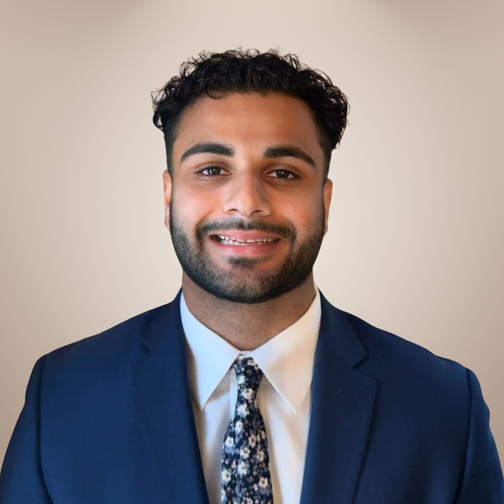
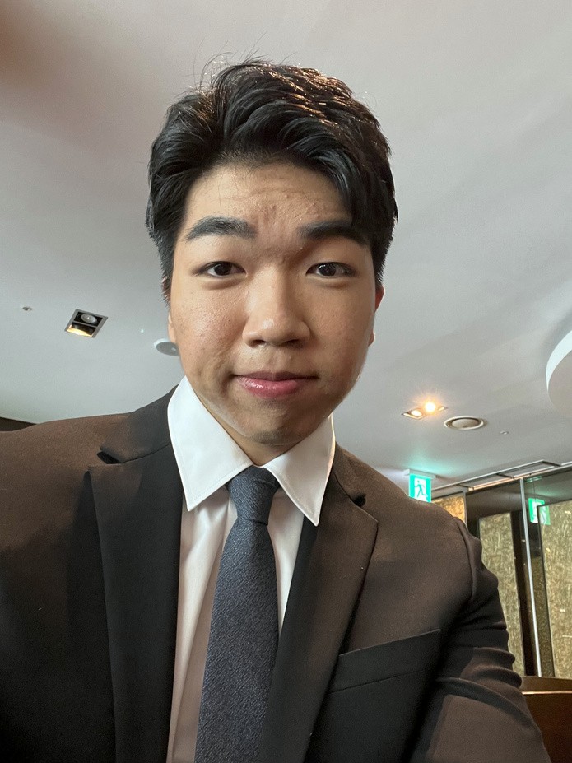
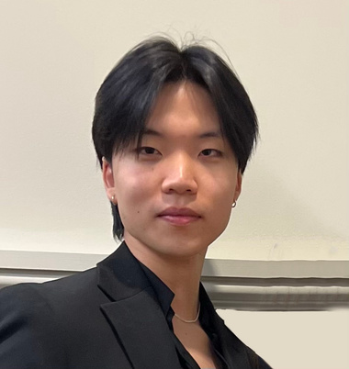
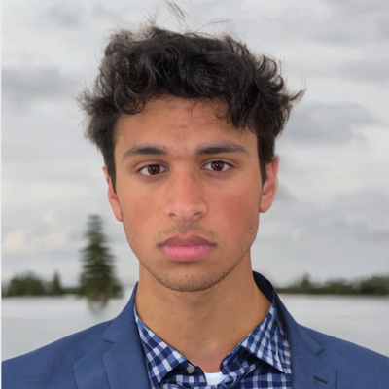
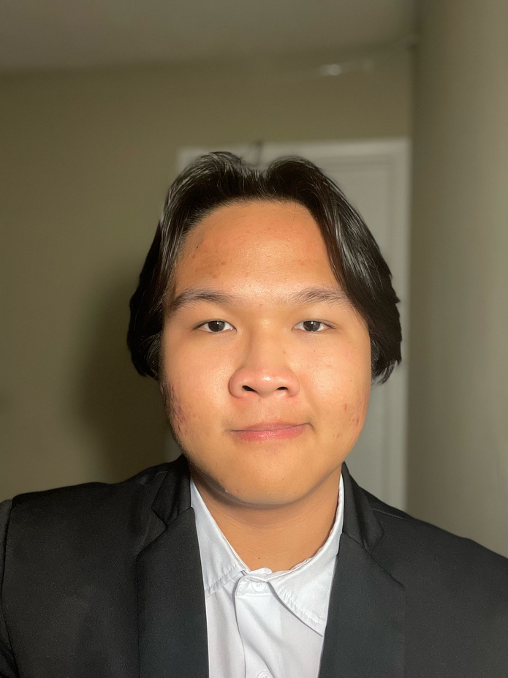

Team
Summary
Timeline
Risks
Roadmap
Wireframe
Demo
Closing
OUR TEAM
Aiman Lalani
Charlie Kim
Jimmy Kim
Ryan Nair
Willie Malonda
Everest Cantu
Project Manager
Team Coordinator
Project Manager
Web Designer
Web Designer II
Ceo Of Ingoude Company

Slide 4

Team
Summary
Timeline
Risks
Roadmap
Wireframe
Demo
Closing
EXECUTIVE SUMMARY
Background
Vision
Execution
We aim to promote KUSA’s online presence by developing a website to share the club’s mission, events, and activities.
The Korean Undergraduate Student Association at the University of Georgia currently faces challenges with its outdated website, hindering effective communication and engagement with members and the broader university community.
Plan
Develop
Implement

Slide 5


Team
Summary
Timeline
Risks
Roadmap
Wireframe
Demo
PROJECT TIMELINE
01
02
03
04
JANUARY
FEBRUARY
MARCH
APRIL
Identify Stakeholders
Identify potential project risks
Identify project scope and how value can be delivered
Meet with stakeholders
Collect data and stakeholder requirements
Begin wireframe design on Wix
Test wireframe for any technical issues
Teach clients wireframe setup
Handover completed wireframe to KUSA for further development.

Slide 6

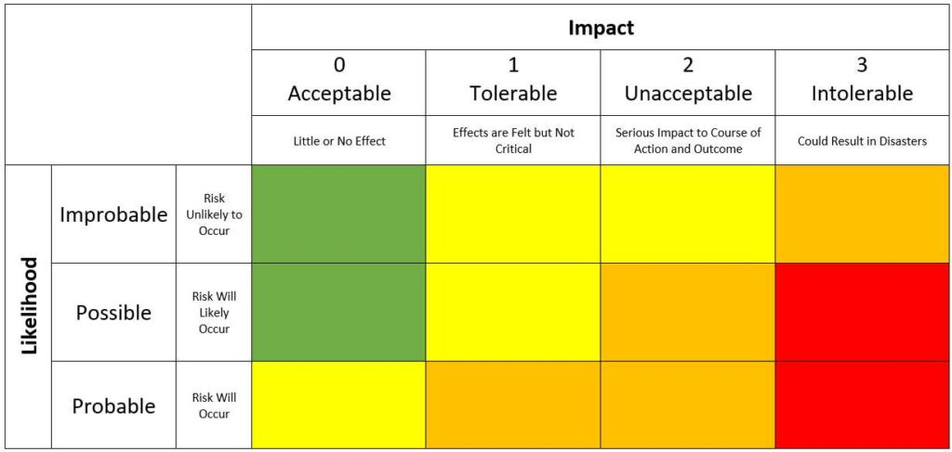
Team
Summary
Timeline
Risks
Roadmap
Wireframe
Demo
Closing
Risk Matrix
1
Technical Challenges
Risk Acceptance
2
Communication Gaps
Risk Mitigation
2
4
3
3
User Adoption Difficulties
Risk Mitigation
1
Content Management Issues
4
Risk Mitigation
Risk Transfer

Slide 7
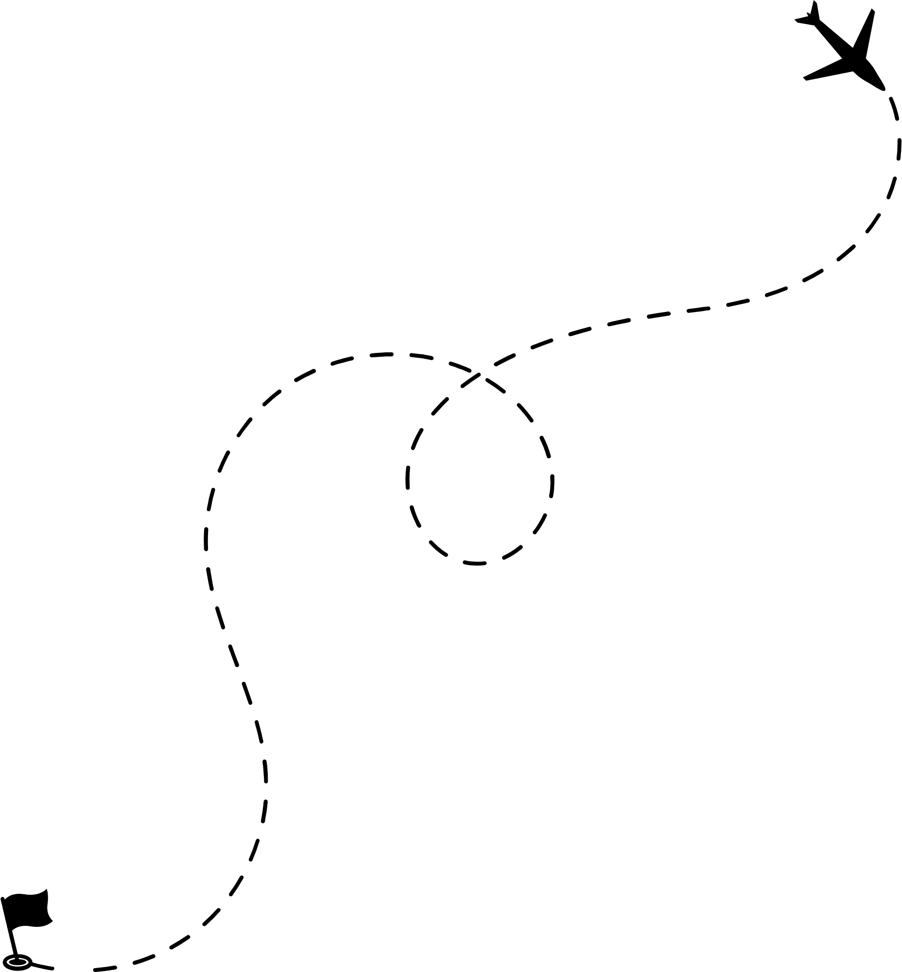
ROADMAP
Team
Summary
Timeline
Risks
Roadmap
Wireframe
Demo
Closing
1. Complete prototype of web site
2. Present prototype to client for feedback
3. Incorporate feedback into the website
4. Assurance testing and improvements
5. Fully implement website and handover to KUSA
6. Celebrate completion of project!

Slide 8
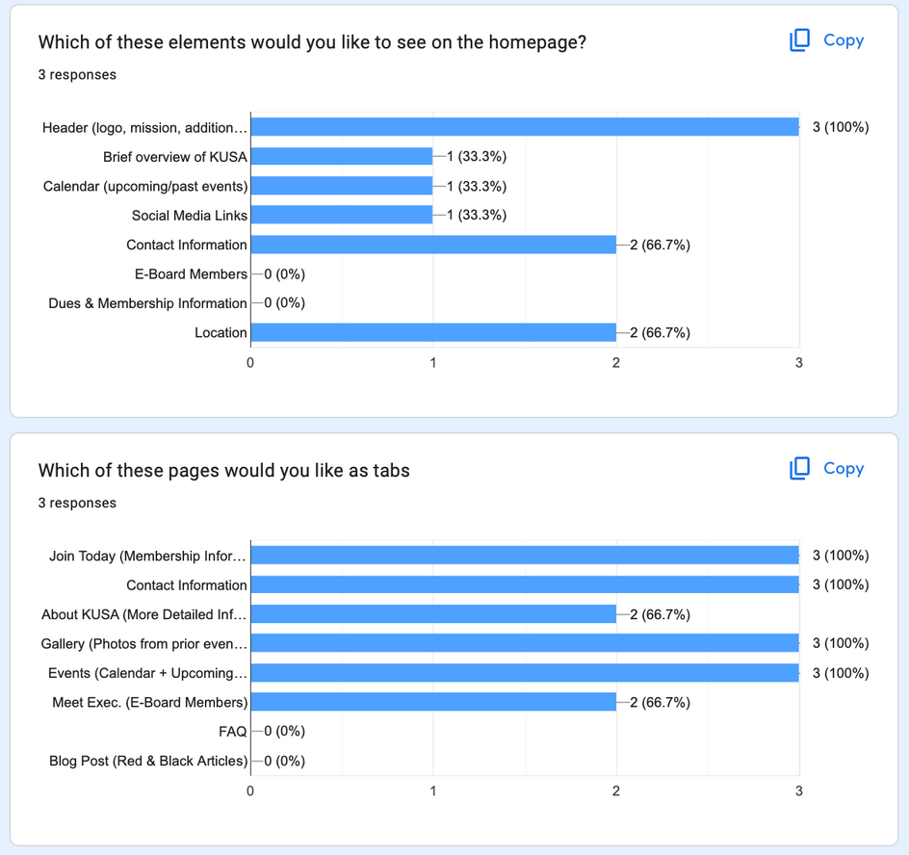
Team
Summary
Timeline
Risks
Roadmap
Wireframe
Demo
Closing
PLANNING & DESIGN
Wireframe Features
Homepage
About Us
Events
Membership
Meet the Team
Gallery
Wireframe Design
Layout
Images
Font
*KUSA E-Board completed a Google Form survey so we could meet their website requirements/preferences.

Slide 9
Team
Summary
Timeline
Risks
Roadmap
Wireframe
Demo
Closing
DEMO

Slide 10

Team
Summary
Timeline
Risks
Roadmap
Wireframe
Demo
Closing
CLOSING OF PROJECT
Acceptance of website from Nicole Kim
Provide Nicole with all deliverables
Update Configuration Management Plan for handoff
Update resume for completion of website
Handover to KUSA
Provide technical assistance during Fall 2024 Add/Drop week

Slide 11

THANK YOU
Questions?

